Slide 1
Mock up test
in ornare quam viverra orci

Slide 2


Slide 3
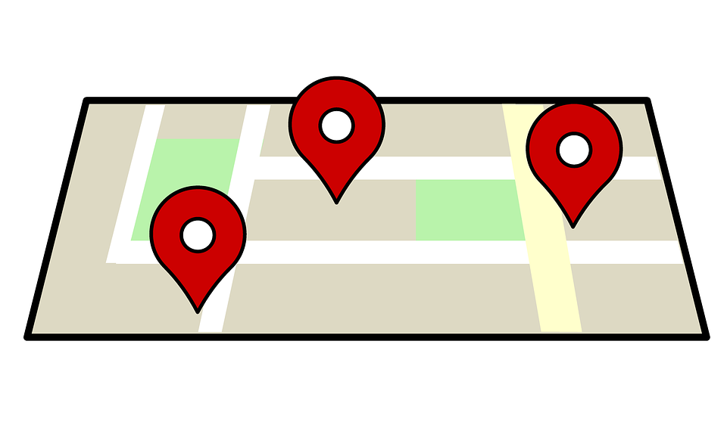

Slide 4
Google Maps, Earth and Satellite: What’s The Difference?
Google Earth and Maps are both helpful tools for exploring the world, but they serve different purposes. Google maps is great if you need directions somewhere, whereas Google Earth is best if you're looking to analyze erosion of a desert based on water and wind patterns.

Slide 5
How to add Google Maps to a website
There are many apps and software with which you can create maps, but not all have the same capabilities. "Expedition" was developed by Lars and Jens Rasmussen as a mapping software program for C++. Google bought the company in an effort to participate in the development of what would lead to Google Maps. The catalyst for Google's interest in Expedition was the application's ability to use AJAX, which allowed users to add pins on the map and "geolocation". AJAX is responsible both for allowing easy pin placement, as well as the inclusion of traffic analysis and geospatial layers. It wasn't long before Expedition turned into Google Maps, launching in 2005. Users share their information with Google Maps, making it relevant and up-to-date with a plethora of data that essentially creates its own narrative every day because it is always changing based on new inputs.

